Slide 1

Red Wine Quality
Computer Science
Wang Peng
Takweh C
Moscow,2023

Slide 2
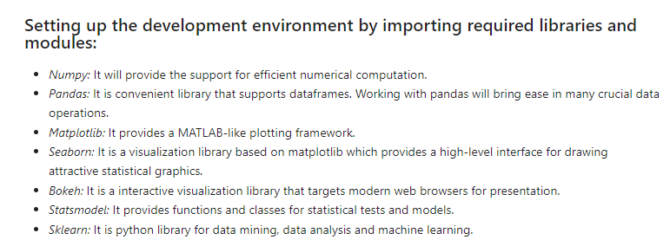
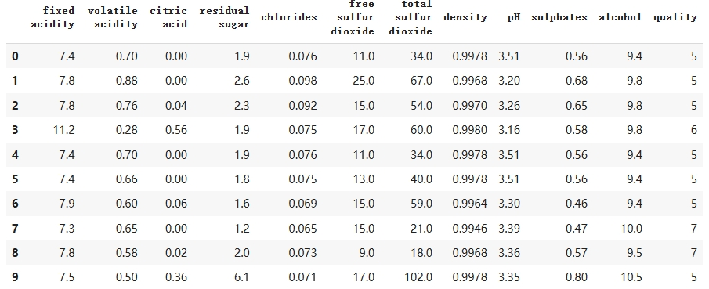
Dataset
Computer Science
Wang Peng
Takweh C
Moscow,2023
All features are float64,and the target(quality) is an interger(1-10)

Slide 3
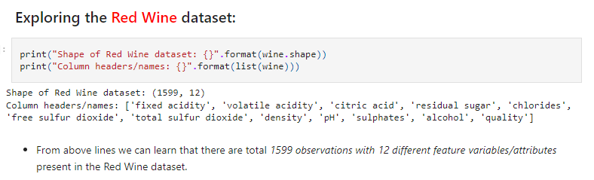
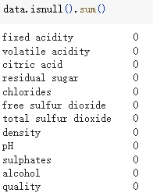
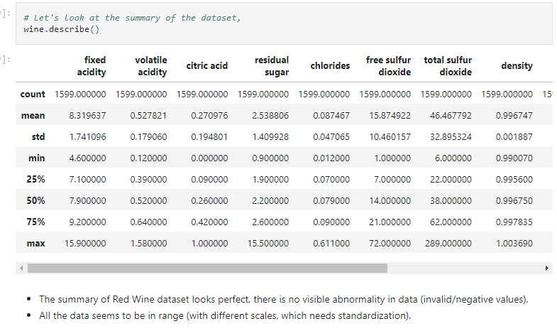
Data preprocessing
Computer Science
Wang Peng
Takweh C
Moscow,2023
None features are null

Slide 4
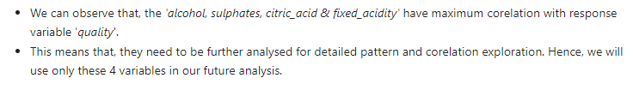
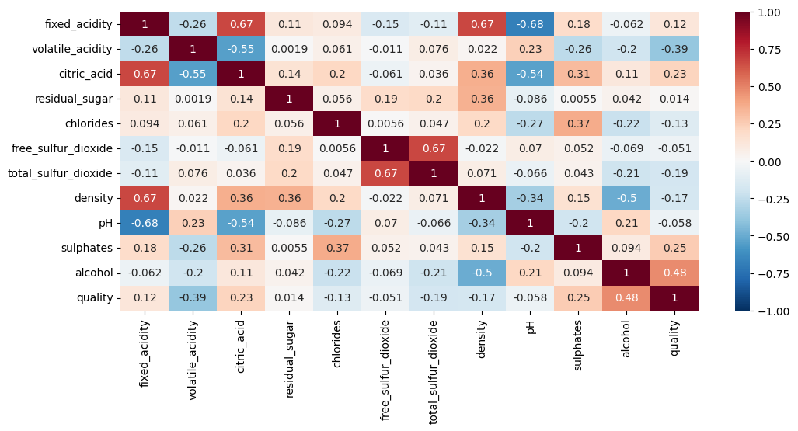
Computer Science
Wang Peng
Takweh C
Moscow,2023
Corelation between features/variables:

Slide 5
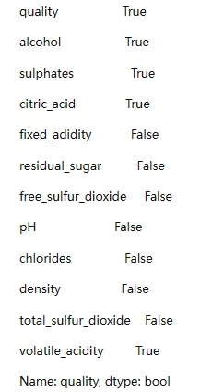
Computer Science
Wang Peng
Takweh
Moscow,2023
Choose features
We choose the features which abs of the correlations beyond 0.2:
alcohol,sulphates,citric_acid,volatile_acidity

Slide 6
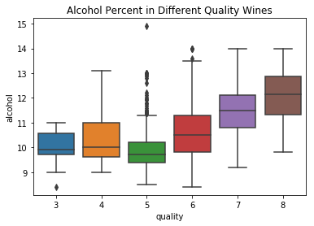
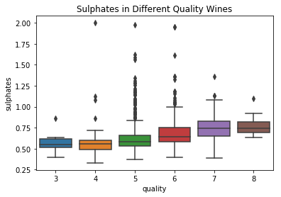
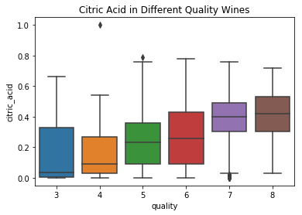
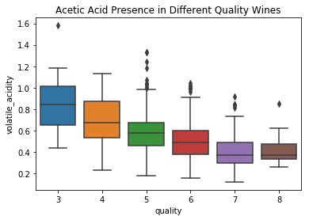
Computer Science
Wang Peng
Takweh
Moscow,2023

Slide 7
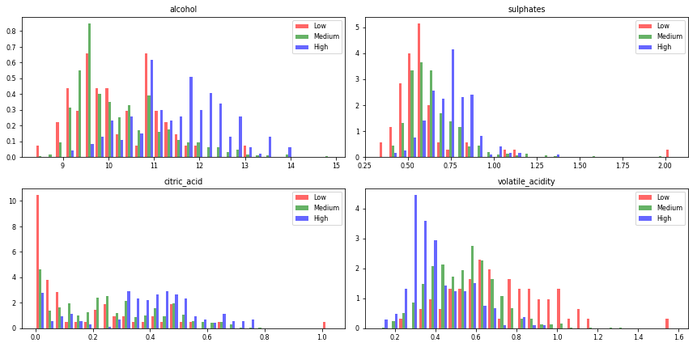
Computer Science
Wang Peng
Takweh
Moscow,2023
Alcohol, sulfate and citric acid are positively correlated,acetic acid is negatively correlated

Slide 8
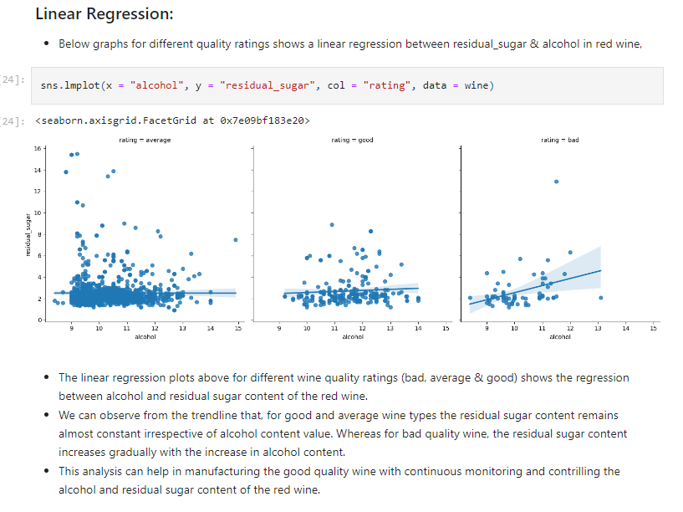
Computer Science
Wang Peng
Takweh C
Moscow,2023
Linear regression

Slide 9
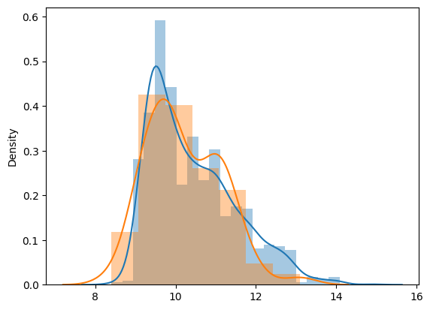
Computer Science
Wang Peng
Takweh
Moscow,2023
Classification using Statsmodel:
We will use statsmodel for this logistic regression analysis of predicting good wine quality (>4).
Let's create a new categorical variable/column (rate_code) with two possible values (good = 1 & bad = 0).
The above plot shows the higher probability for red wine quality will be good if alcohol percentage is more than equal to 12, whereas the same probability reduces as alcohol percentage decreases.

Slide 10
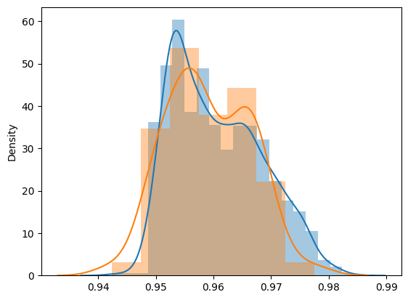
Computer Science
Wang Peng
Takweh
Moscow,2023
The above distribution plot displays the overlapped outcomes for the good and bad quality plots of the red wine.
We can observe that the precision for the good wine prediction is almost 96% accurate, where as for bad wine its only 4%, which is not good. But overall there is 92% average precision in wine quality rate prediction.

Slide 11
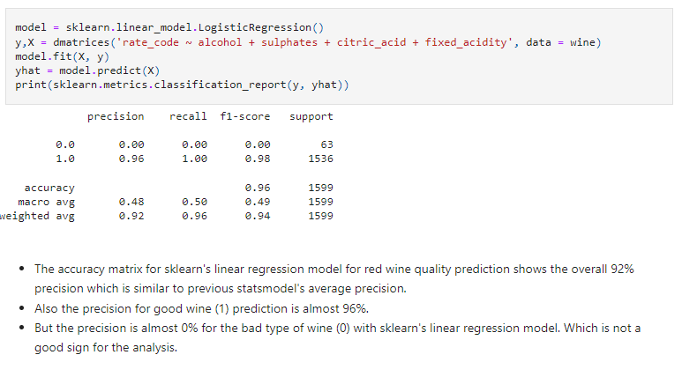
Computer Science
Wang Peng
Takweh
Moscow,2023
Classification using Sklearn's LogisticRegression:

Slide 12
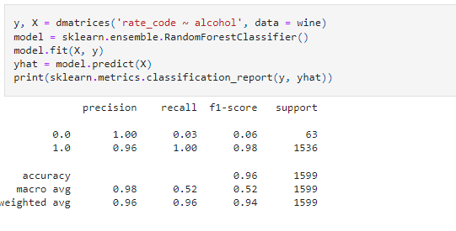
Computer Science
Wang Peng
Takweh
Moscow,2023
Classification using Sklearn's RandomForestClassifier:

Slide 13
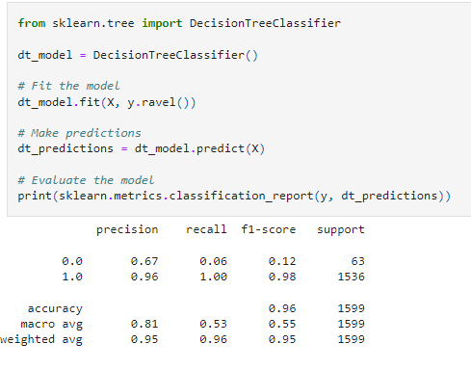
Computer Science
Wang Peng
Takweh
Moscow,2023
Classification using Decision Tree Classifier:

Slide 14
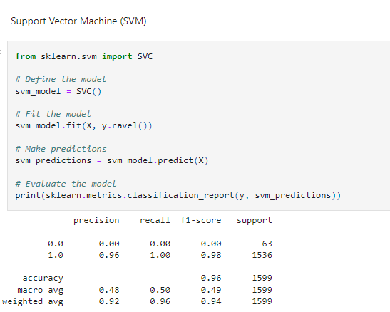
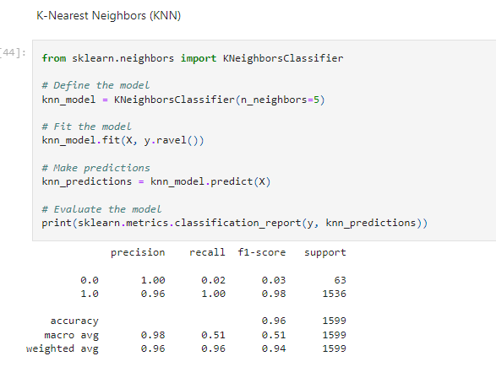
Computer Science
Wang Peng
Takweh
Moscow,2023
Classification using Support Vector Machine (SVM) and K-Nearest Neighbors (KNN)

Slide 15
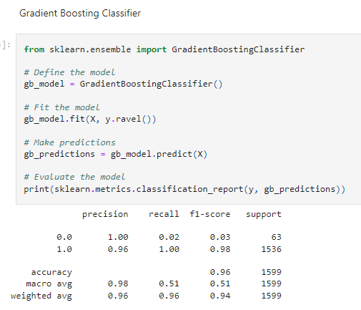
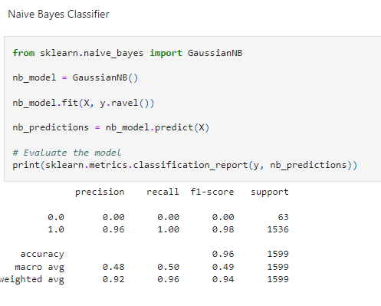
Computer Science
Wang Peng
Takweh
Moscow,2023
Classification using Gradient Boosting Classifier and Naive Bayes Classifier

Slide 16
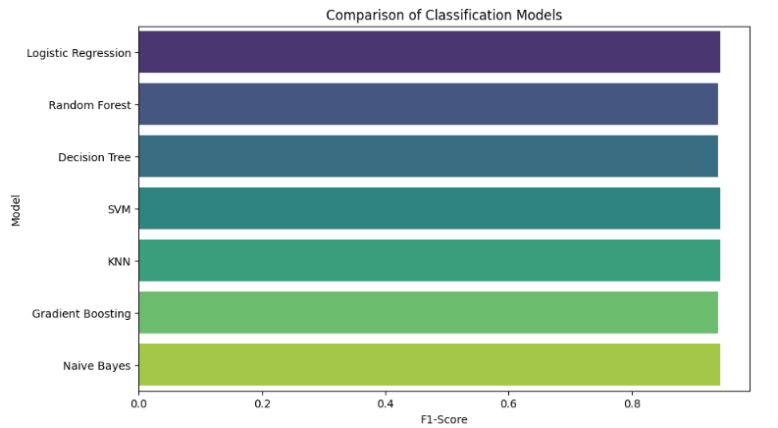
Computer Science
Wang Peng
Takweh
Moscow,2023
Putting everything together

Slide 17
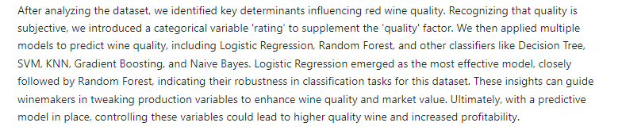
Computer Science
Wang Peng
Takweh
Moscow,2023
Conclusion

Slide 18
Thanks for your attention.

